Slide 1


Introduction, Background on Sets, Relations, and Graphs Session No.: 01 Course Name: Theory of Computation Course Code: R1UC501T Instructor Name: Arvind Kumar Duration: 50 Minutes Date of Conduction of Class: 16 -02-2026

Slide 2

Key concepts of session no. 1

Slide 3

Reflect on the responses of post session activity

Slide 4

Opening Question
“Imagine you're designing a simple robot that takes input commands like 'move forward' or 'turn left’.
How would you represent these commands and the robot’s behavior using mathematics or diagrams?”

Slide 5
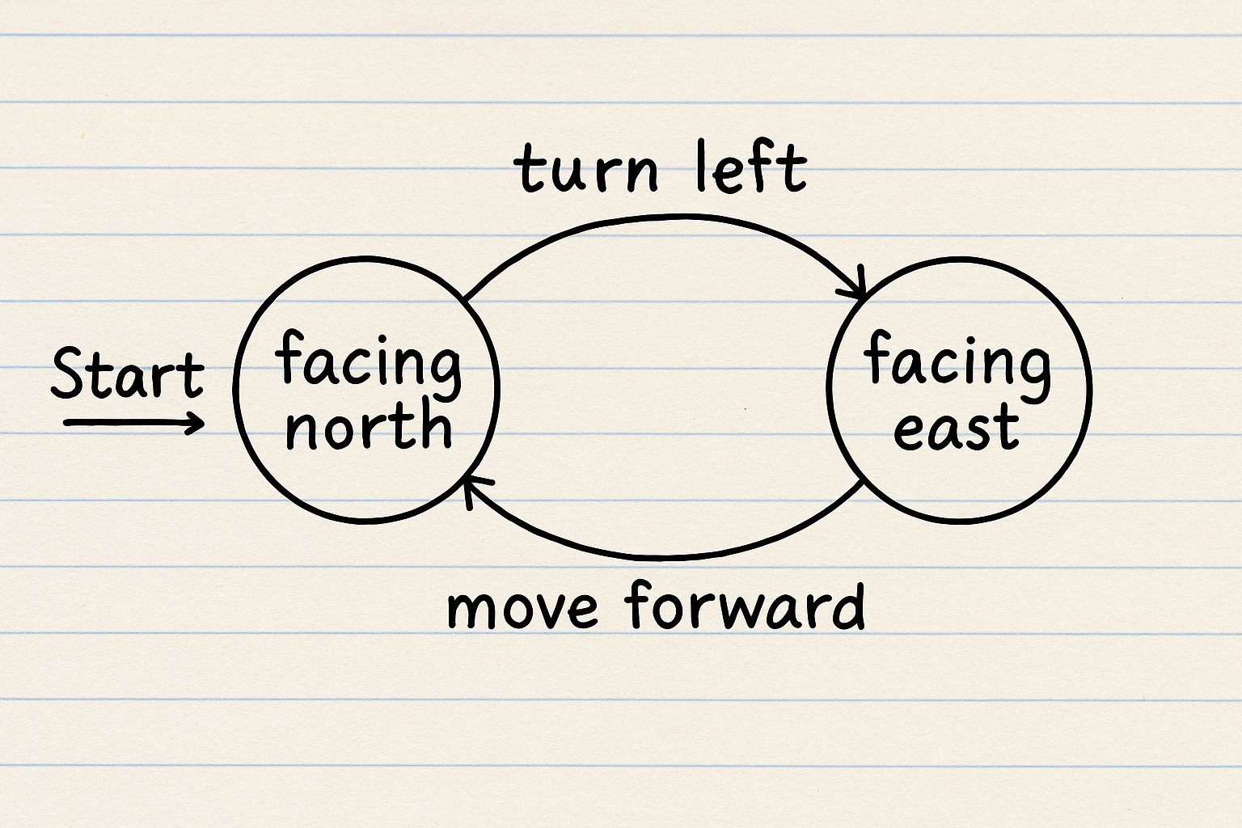

Slide 6
At the end of this session students will be able to
LO1:
Understand and apply the fundamental concepts of sets, relations, and graphs to model and analyze computational problems
LO2:
Develop the ability to represent and interpret the behavior of simple computational systems using set notation, relation properties, and graph diagrams.

Slide 7
Session Outline
1. Introduction
2. Sets
3. Relations
4. Graphs
5. Activities

Slide 8

Introduction
Theory of Computation is the study of how computers solve problems using step-by-step instructions (algorithms), and what problems can or cannot be solved.
Main Parts of ToC:
1. Automata Theory – Study of machines like DFA, NFA.
2. Formal Languages – Study of programming language structure.
3. Computability – What can or can’t be computed.
4. Complexity – How much time or memory an algorithm uses.
Why learn it?
• To build better software, like compilers and interpreters.
• To know the limits of computation.
• To write efficient programs.

Slide 9
Sets
A set is a collection of items (called elements).
Examples:
A = {1, 2, 3}
B = {apple, banana, mango}
Types of Sets:
• Empty Set: Ø or {} → no elements (e.g., students with 100% in all subjects)
• Finite Set: Limited elements (e.g., A = {2, 4, 6})
• Infinite Set: Unlimited elements (e.g., Natural numbers = {1, 2, 3,...})

Slide 10
Set Operations:
Let A = {1, 2, 3}, B = {3, 4, 5}
Union (A ∪ B) = {1, 2, 3, 4, 5}
Intersection (A ∩ B) = {3}
Difference (A − B) = {1, 2}
Cartesian Product:
A = {1, 2}, B = {a, b} ⇒ A × B = {(1, a), (1, b), (2, a), (2, b)}

Slide 11
Relations
A relation connects elements of one set to another.
Example:
A = {1, 2}, B = {x, y}, R = {(1, x), (2, y)}

Slide 12
Properties of Relations:
Let A = {1, 2, 3}
Reflexive: (a, a) ∈ R for all a ∈ A
Example: R = {(1,1), (2,2), (3,3)}
Symmetric: If (a, b) ∈ R then (b, a) ∈ R
Example: R = {(1,2), (2,1)}
Transitive: If (a, b), (b, c) ∈ R, then (a, c) ∈ R
Example: R = {(1,2), (2,3), (1,3)}
Antisymmetric: If (a, b) and (b, a) ∈ R, then a = b
Example: R = {(1,2)} is antisymmetric

Slide 13
Graphs
A graph is a set of points (vertices) connected by lines (edges).
Example:
V = {A, B, C}, E = {(A, B), (B, C)} → A is connected to B, and B to C
Types of Graphs:
• Undirected Graph: A—B
• Directed Graph (Digraph): A → B
• Weighted Graph: A —(5)— B
• Cyclic Graph: A → B → C → A
• Acyclic Graph: A → B → C

Slide 14
Use in Computation:
• Nodes represent states.
• Edges represent transitions.
• Used in DFA, NFA, and syntax trees.

Slide 15
Learning Activity 1: Think-Pair- Share(Use Wooclap)
Think – Individually, each student creates two small sets related to real-life data (e.g., A = {2, 4, 6}, B = {3, 4, 5}).
Pair – Students pair up and compute A ∪ B, A ∩ B, A − B, and A × B.
Share – Each pair shares their results with the class. The instructor guides the discussion, reinforcing correct reasoning.

Slide 16
Learning Activity 1:

Slide 17

Learning Activity 2: Code Based Learning
Robot Movement Simulation
Objective:
To help students model relations and graphs using a real-world scenario.
Case Scenario:
A robot receives commands: start, move, turn left, turn right, and stop. Based on these, it transitions through states like Idle, Moving Forward, Turning, and Stopped.
Steps:
Students are divided into small groups.
Each group :draw a directed graph representing the state transitions, present and explain their models.

Slide 18
Summary
What ToC is – Study of how computers solve problems and what they can or cannot do.
Sets – Groups of items; used for alphabets, states, and strings in computation.
Relations – Links between items; used to describe how machines change from one state to another.
Graphs – Points connected by lines; used to show machines and their transitions.
Why they matter – Sets, relations, and graphs help design and understand computational models like DFA and NFA.

Slide 19
Ensure attainment of LOs in alignment to the learning activities:
LO1:
Understand and apply the fundamental concepts of sets, relations, and graphs to model and analyze computational problems.
LO2:
Develop the ability to represent and interpret the behavior of simple computational systems using set notation, relation properties, and graph diagrams.

Slide 20

Discussion on the post session activities (Submit the answers through LMS)

Slide 21
Information about the next lesson
Introduction to Finite State Machine (FSM) with example and applications of Finite Automata

Slide 22


Feedback and Queries

